Slide 1

Electricity Consumption Prediction using Machine Learning
Radit Rahmadhan
29020003
Supervised by
Meditya Wasesa , S.T., M.Sc., Ph.D.

Slide 2
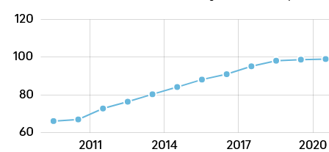
Introduction
The increasing number of electricity users in Indonesia from 2010 to 2020 is around 33.25%
Source : Katadata.co.id

Slide 3

Introduction
Based on the results of interviews conducted by several PLN customers, they stated that blackouts in the West Sumatra area were very frequent, even in a month it could reach 4 times a month.
Source : Interview Results from several PLN customers in the West Sumatra Zone

Slide 4
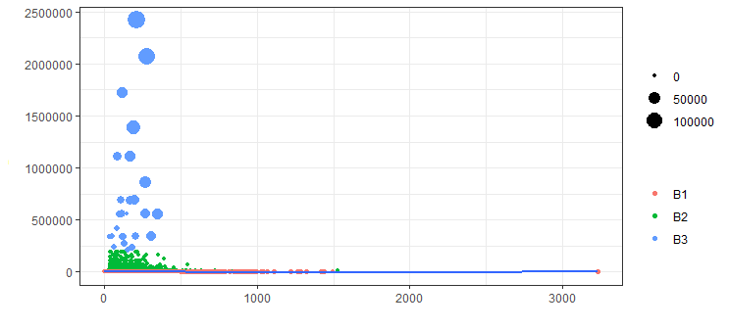
Introduction
Kwh Peak Load
Based on the analysis that has been done, the average monthly business customer uses electricity below 50 per hour
Power
Rates
Flash Time
Source : PLN customer transaction data for West Sumatra Region from 2019 to 2020

Slide 5
Introduction
The Manager for Commercial Administration stated that the blackout occurred due to the use of too high peak loads so that it used up the available power while the available power provided by off-peak loads was used little.
Source : PLN customer transaction data for West Sumatra Region from 2020 and Interview with the West Sumatra Regional Commercial Administration Manager

Slide 6

Research Question
How to increase the electricity consumption of business customers by identifying the characteristics of customers who use electricity at peak load times?

Slide 7
Objective
This study aims to develop a prediction model for peak load electricity consumption to characterize customers based on electricity usage time .
These findings can help companies identify potential customers using higher peak loads

Slide 8
Literature Review
Article | Business Context | Dataset | Segmentation Features | Techniques
Vucetic et al,2018 | Marketing | Restaurant customer feedback data period January 1, 2016, to December 31, 2016 | Customer name, type of food ordered, food review, gender | K-Means using PL based algorithm
Aziz et al, 2019 | Small Medium Enterprise | SME customers are all pulse server operators AR-Pulsabiz Malang Indonesia period January 1, 2018, to June 30,2018 | ID Customer, Length, Recency, Frequency, Monetary | K-Means Clustering and LRFM Model
Ye Jingyi, 2021 | E- Commerce | Online Retail Data Set period 12 January 2010 and 12 September 2011 from UK | Invoice No, Stock Code, Description, Quantity, Invoice Date, Unit Price, Customer ID, Country, Total Price | K-Means Clustering
McLoughlin et al, 2014 | Electricity | Experimental data by installing smart meters to more than 4000 residences in Ireland, period January 1, 2009, to December 31, 2010 | Dwelling type, No. of bedrooms, Age, Social Class, Electronic Type | k-means, k-medoid and Self Organizing Maps (SOM)

Slide 9
Method

Slide 10
Data Collection
PLN Data from West Sumatra Region
Data | Year | Row | Variable
Customer Transaction | 2019 | 8,305,831 | 90
Customer Transaction | 2020 | 9,705,831 | 90

Slide 11
Data Processing
Data Period | Filter
 | Variable | Rates | Group Code | Customer Service Area | Row
January 2019 - December 2020 | 49 | - | - | - | 18,011,662
January 2019 - December 2020 | 31 | - | - | - | 18,011,663
January 2019 - December 2020 | 27 | - | - | - | 18,011,664
January 2019 - December 2020 | 18 | - | - | - | 18,011,665
January 2019 - December 2020 | 15 | - | 0 | Padang | 1,187,934
January 2019 - December 2020 | 13 | Business | 0 | Padang | 508,934

Slide 12
Result Data Processing
Variable | Numeric/Nominal | Data Type | Variable Description
Customer Service Unit | Factor | String | Customer Service Units or service branches provided by the company which are located in 4 customer service centers namely Belanti, Painan, Indarung, Pariaman, Lubuk Basung, Lubuk Sikaping, Koto tuo, Baso, Sijunjung, Sungai Rumbai, Kayu Aro, Sawah Lunto, Batusangkar, Lintau, Lima Puluh Kota and others
Data Entry Date |  | Date | Admin enters data per 1 month
Rates | Factor | String | B1 means a business that uses electricity from 450 kwh to 5500 kwh, B2 means a business that uses electricity from 6600 to 200 thousand kwh, B3 means a business that uses 200 thousand kwh of electrical power and above
Power | Factor | Integer | Power used by customers such as 450 kwh,900 kwh,1300 kwh, 2200 kwh,3300 kwh, 7700 kwh,15400 kwh,132000 kwh,110000 kwh and others
Meter Code | Factor | String | M means analog meter and E means digital meter
Flash time |  | Double | Electricity usage time by customer
Total KWH |  | Integer | The total of peak load kwh usage and peak external load kwh used by customers
KWH Off - Load |  | Integer | KWH used at peak external load by customers
KWH Peak Load |  | Integer | KWH used at peak load by customers
Discount |  | Double | Discounts given by the company based on the provisions of the company such as using unused kwh by the company or because of a natural disaster
Peak Offload Fee |  | Double | Payments made when using Peak Offload
Peak Load Fee |  | Double | Payments made when using Peak Load
Total Cost |  | Double | The total cost paid by the customer

Slide 13
Choice of Variable

Slide 14
Choice of Segmentation
Segmentation | Category
 | Flash Time
Small Business | 1 hour- 49 hour
Medium Business | 50 hour - 99 hour
Big Business | > 100 hour

Slide 15
Prediction Model Choice

Slide 16
Result

Slide 17

Conclusion
Based on the results that have been processed, the xxx model is the best for predicting the peak load kwh used by customers based on flash time
This finding is the first to help companies estimate the power to be provided so they can avoid blackouts by diverting peak-load electricity consumption to off-peak power consumption by providing discounts, bonuses or campaigns provided by the company.
Second, it can help the company in estimating monthly income to plan the allocation of budget costs for next year so that it will improve the company's programs in the future

